Slide 1
Pushdown Automata
Anab Batool Kazmi

Slide 2
Types of Automata
Types
Finite Automata
Deterministic
Non deterministic
Pushdown Automata
Non deterministic
Turing machine
Deterministic

Slide 3
PDA
A pushdown automaton is a way to implement a context-free grammar in a similar way we design DFA for a regular grammar. A DFA can remember a finite amount of information, but a PDA can remember an infinite amount of information.
When stack structure is incorporated into an FA, its language-recognizing capabilities are increased considerably.
PDA == {Finite Automata + Stack}

Slide 4
develop a slightly different pictorial representation for FA's,

Slide 5
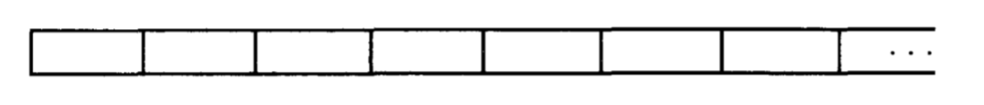
Input Tape
To store the input string
The TAPE must be infinitely long (such a tape is very expensive).
The TAPE has a first location for the first letter of the input, then a second location, and so on.
Therefore, we say that the TAPE is infinite in one direction only.

Slide 6
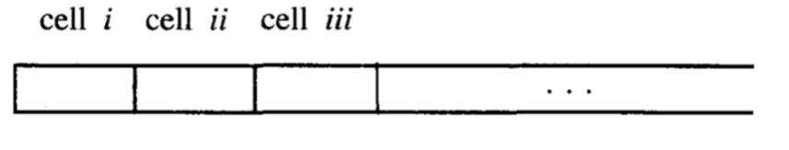
Input Tape
The locations into which we put the input letters are called cells.
We name the cells with lowercase Roman numerals.

Slide 7
Input Tape
The character "∆" is used to indicate a blank in a TAPE cell.
example of an input TAPE already loaded with the input string aaba.

Slide 8
Input Tape
As we process this TAPE on the machine we read one letter at a time and eliminate each as it is used.
When we reach the first blank cell we stop.
When the character "∆" is read from the TAPE, it means that we are out of input letters. We are then finished processing the input string.
We always presume that once the first blank is encountered the rest of the TAPE is also blank.
We read from left to right and never go back to a cell that was read before.

Slide 9
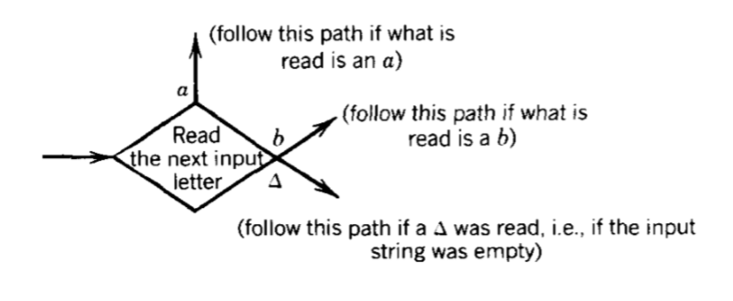
READ States
The most important job performed by a state in an FA is to read an input letter and branch to other states depending on what letter has been read.

Slide 10
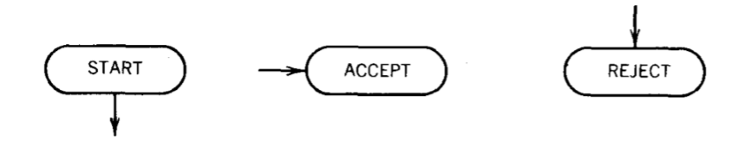
Start , Accept , Reject states
The START state is like a state connected to another state in a TG by a ^ edge.
ACCEPT state is a dead-end final state- once entered, it cannot be left
REJECT state is a dead-end state that is not final.

Slide 11
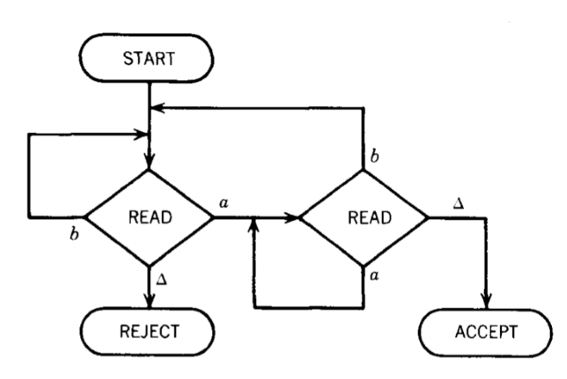
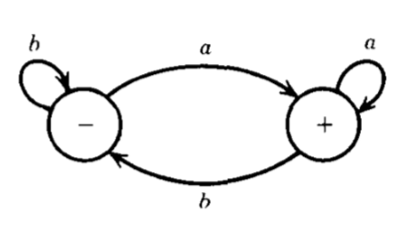
FA that accepts all words ending in the letter a

Slide 12
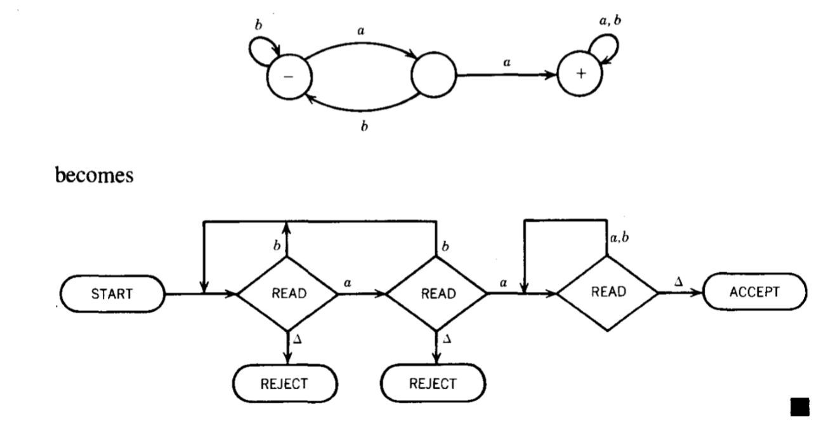
Contains substring aa

Slide 13
Push Down Automata

Slide 14
PDA
Input tape
Start State
Accept State
Reject State
Read State
Stack
Push state
Pop state

Slide 15
Pushdown stack/ Pushdown store
A PUSHDOWN STACK is a place where input letters (or other information) can be stored until we want to refer to them again. It holds the letters it has been fed in a long line (as many letters as we want).
A PUSHDOWN STACK is called a LIFO file standing for "the LAST IN is the FIRST OUT,"
The only STACK operations allowed to us are PUSH and POP.
It is not like the normal storage area of a computer, which allows random access (we can retrieve stuff from anywhere regardless of the order in which it was fed in). A PUSHDOWN STACK lets us read only the top letter.

Slide 16
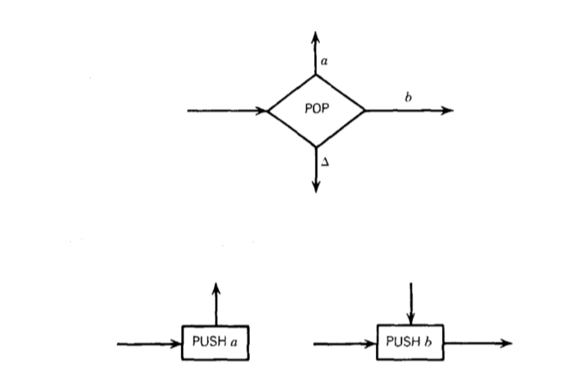
Push and Pop states

Slide 17

Example: $L=\{a^{n}b^{n} where n≥0\}$
Read a’s from input tape and Push them in the stack
Read b’s from input tape and Pop the stack
If |a|’s in the stack = = |b|’s in the input tape it means the string is acceptable otherwise string in rejected
String = aaabbbb

Slide 18
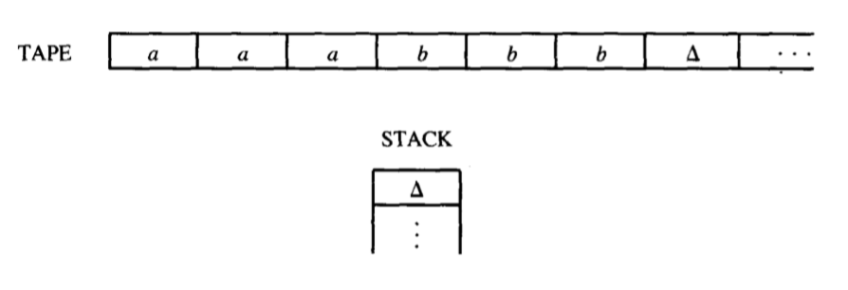
Initial memory and stack

Slide 19
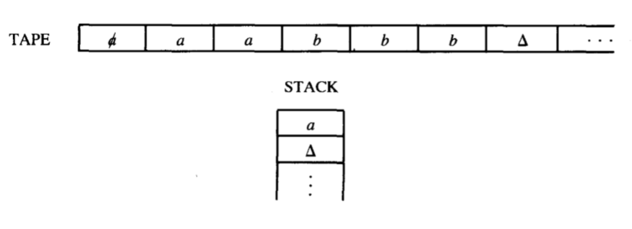
Read a , push it in stack

Slide 20
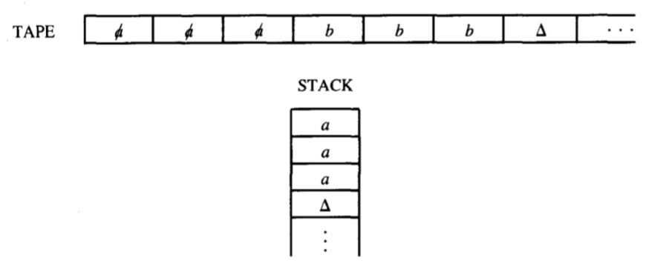
Read 2nd “a” and Push, then read 3rd “a” and Push

Slide 21
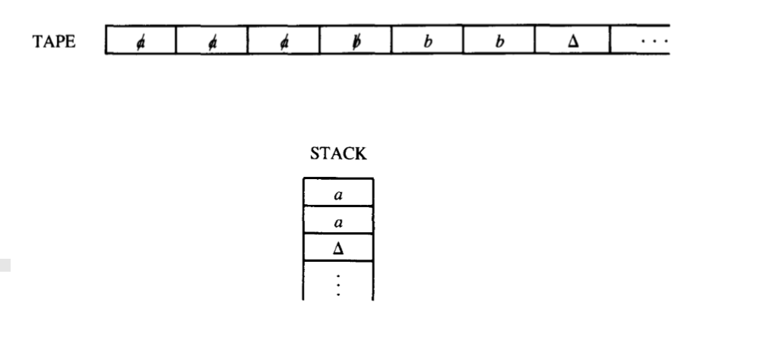
Read ‘b’ and Pop

Slide 22
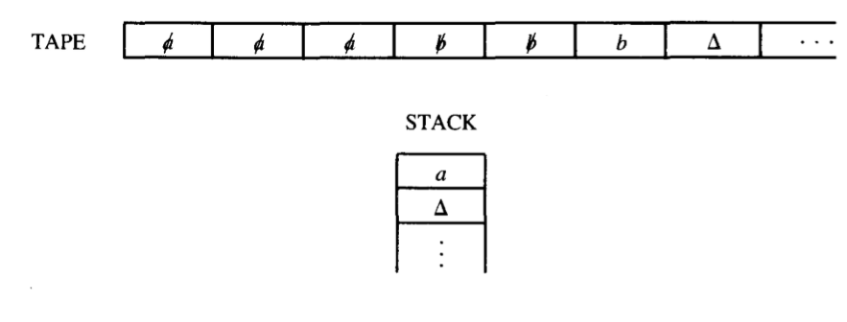
Read 2nd ‘b’ and pop

Slide 23
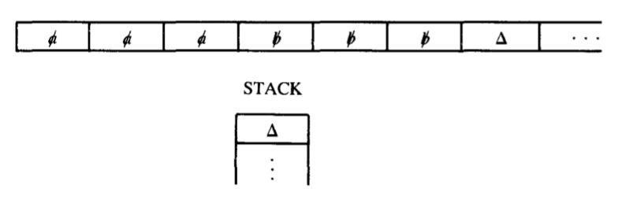
Read 3rd b and pop

Slide 24
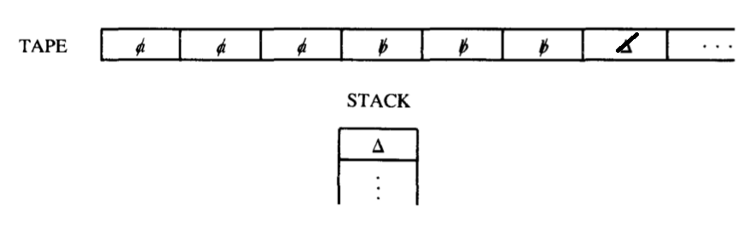
Read null and pop

Slide 25
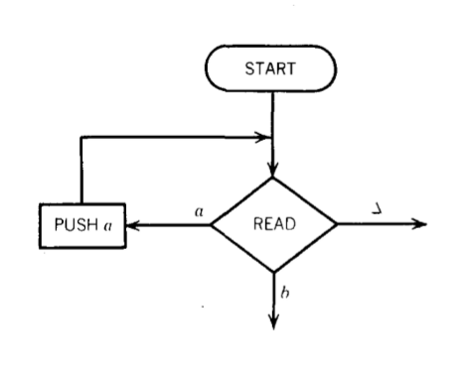
The first part of machine Read a from Tape
read from the TAPE some number of a's in a row and push them into the STACK.
This is the only place in the machine where anything is pushed into the STACK. Once we leave this circuit, we cannot return, and the STACK contains everything it will ever contain.

Slide 26
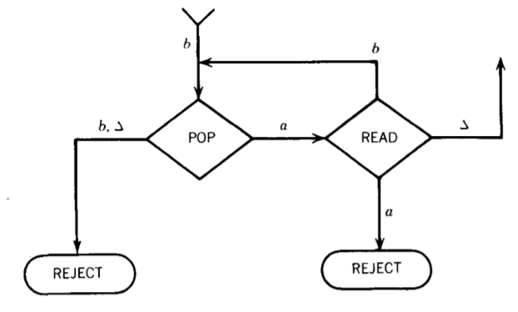
2nd part: Read b
Read and pop()
if read == b and pop()== ∆ or b
Reject (#of a’s either == 0 or <b )
elif read == b and pop()== a
again read and pop()
elif read == a
Reject (it means we have mix string)

Slide 27
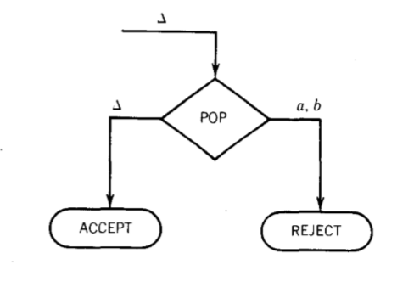
3rd part
Read b pop()== a then read ∆
again pop()
if pop() == ∆
Accept
if pop() == a
Reject (it means |a| > |b|)
if pop() == b
Reject (its impossible)

Slide 28
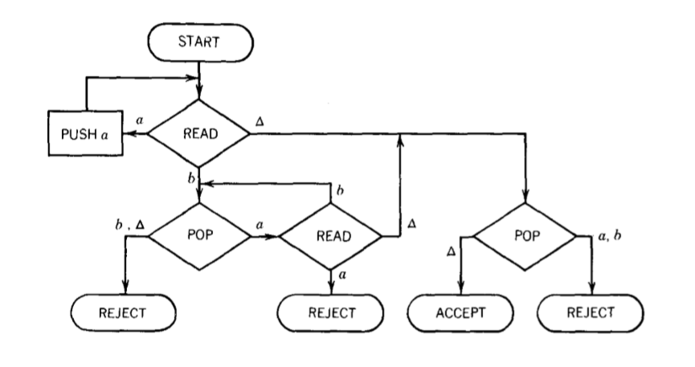
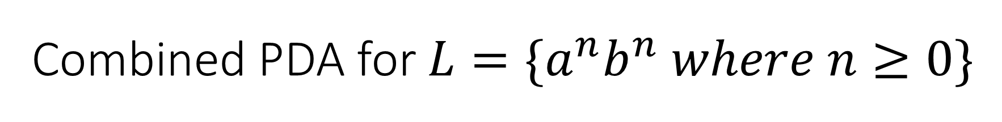
Combined PDA for $L=\{a^{n}b^{n} where n≥0\}$

Slide 29

QUIZ
Draw PDA for the following language
$$L=\left\{a^{n+1}b^{n} where n≥1\right\}$$
DESCRIPTIVE FORM= {aab, aaabb, aaaabbb, ….}

Slide 30
Example: Language PALINDROMEX
PALINDROMEX = s X reverse(s) where s is any string in (a + b)*.
The words in this language are
{ X, aXa, bXb, aaXaa, abXba, baXab, bbXbb, aaaXaaa, aabXbaa ,. . . }
The input alphabet ∑= {a, b, X}
The STACK alphabet has two letters Γ= {a, b}, so each POP has three edges coming

Slide 31
PDA for
the first part of the machine the STACK is loaded with the letters from the input string before X
When we read the X we know we have reached the middle of the input.
We can then begin to compare the front half of the word (which is reversed in the STACK) with the back half (still on the TAPE) to see that they match.

Slide 32
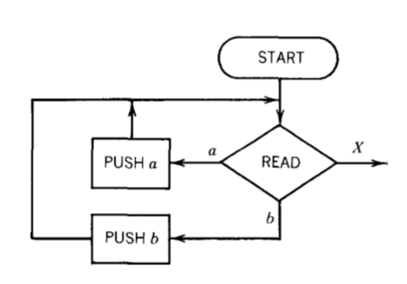
Part 1: Storing the front half of the input string in the STACK
If we READ an a, we PUSH an a. If we READ a b, we PUSH a b, and on and on until we encounter the X on the TAPE.

Slide 33
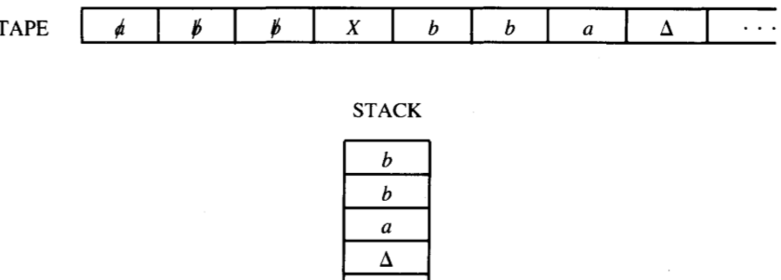
After we take the first half of the word and stick it into the STACK, we have reversed the order of the letters and it looks exactly like the second half of the word. For example, if we begin with the input string abbXbba

Slide 34
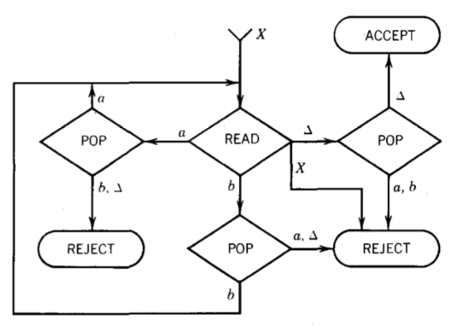
Part 2: After we read X
When we read the X we do not put it into the STACK. It is used up in the process of transferring us to phase two. This is where we compare what is left on the TAPE with what is in the STACK. In order to reach ACCEPT, these two should be the same letter for letter, down to the blanks.

Slide 35
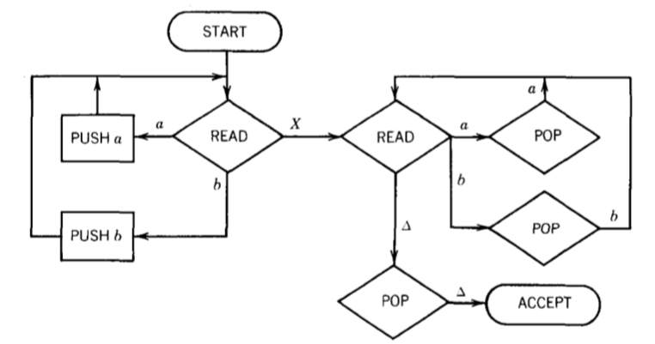
Final PDA
We can draw a less complicated picture for this PDA without the REJECT states if we do not mind having an input string crash when it has no path to follow.

